Slide 1
OOP
Javadoc
Based on Barnes and Kolling Chapter 5
Notes:
PIJ/SDJ Lec 9: Applications & javadoc
© Swinburne & © Pearson Education IncA Bayley

Slide 2
Learning Objectives
  Students must
    understand the importance of documenting code and know how to effectively document code using javadoc style
Notes:
SDJ Lecture 9: Creating Reliable Programs
© Swinburne & © Pearson Education IncA Bayley
A Bayley

Slide 3
Why is documentation important
Selfish reasons
  You will understand the code 3 months later
  It will give you better marks
  You will/might impress your boss
  You will/might impress your client
Selfless reasons
  Makes code easier to maintain
  Allows others to continue work on your project
  Your code can be reused later for another project
Notes:
SDJ Lecture 9: Creating Reliable Programs
© Swinburne & © Pearson Education IncA Bayley
A Bayley

Slide 4
How should you document?
Your own classes should be documented the same way the java API library classes are.
Other people should be able to use your class without reading the implementation.
  (This does not mean you can ignore documenting the internal workings of your class)
Notes:
SDJ Lecture 9: Creating Reliable Programs
© Swinburne & © Pearson Education IncA Bayley
A Bayley

Slide 5
javadoc
Class comment:
/**
* The Responder class represents a response
* generator object. It is used to generate an
* automatic response.
*
* @author Michael Kölling and David J. Barnes
* @version 1.0 (30.Mar.2006)
*/
Must be after imports.
Will be re-paragraphed unless format is controlled using html tags.
Can have multiple @author tags.
Notes:
SDJ Lecture 9: Creating Reliable Programs
© Swinburne & © Pearson Education IncA Bayley
A Bayley

Slide 6
Elements of documentation
The documentation for each constructor and method should include:
a description of the purpose and function of the method
the return type
a description of the value returned
the parameter names and types
a description of each parameter
Notes:
SDJ Lecture 9: Creating Reliable Programs
© Swinburne & © Pearson Education IncA Bayley
A Bayley

Slide 7
javadoc
Method comment:
(from Code 5.8)
/**
* Read a line of text from standard input (the
* console), and return it as a set of words.
*
* @param prompt A message to print to screen.
* @return A set of Strings, where each String is
* one of the words typed by the user
*/
public HashSet<String> getInput(String prompt)
{ ...
Notes:
SDJ Lecture 9: Creating Reliable Programs
© Swinburne & © Pearson Education IncA Bayley
A Bayley

Slide 8
Tag format
@param parameterName parameter_description
@return Description_of_value_returned
space
space
DON’T give the type. Think of something useful, eg assumptions
space
DON’T just give the type. Think of something useful, eg when things go wrong

Slide 9
Tag format 2
@throws ExceptionClassName Circumstances_when_thrown
@see some_URL
@deprecated Why this shouldn’t be used, what should be.
space
space

Slide 10
Generating API pages using javadoc
From command line:
  javadoc Temperature.java
    Create html for Temperature.java in the current directory
  javadoc *.java
    Create html for all source files in the current directory
Normally we want html files in a subdirectory, with a title for the whole project, etc
  See javadoc –help
  Or, use an API…

Slide 11
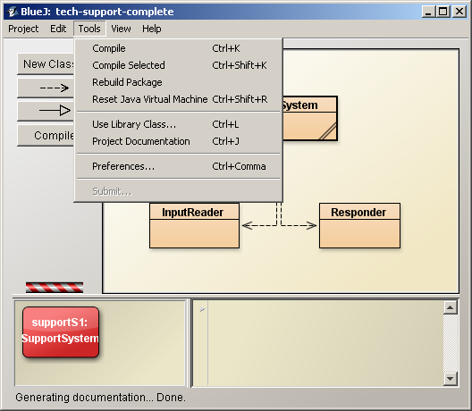
javadoc from BlueJ
Creates subdirectory
doc\
allclasses-frame.html
. . .
index.html
. . .
InputReader.html
Responder.html
SupportSystem.html
. . .
resources\
. . .
Opens browser to show it

Slide 12
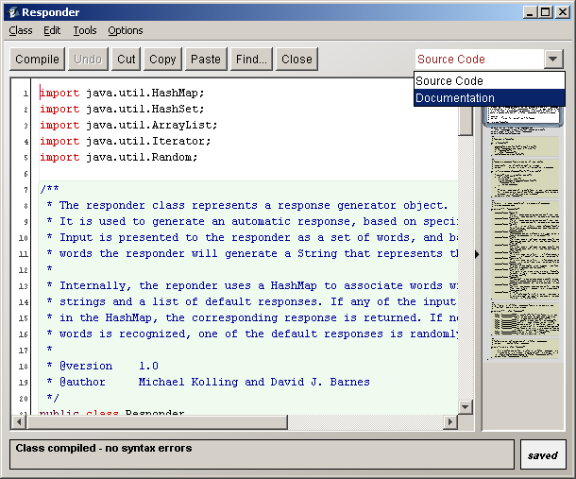
From BlueJ Editor
Also generates
doc\
Flips editor frame to browser mode…

Slide 13
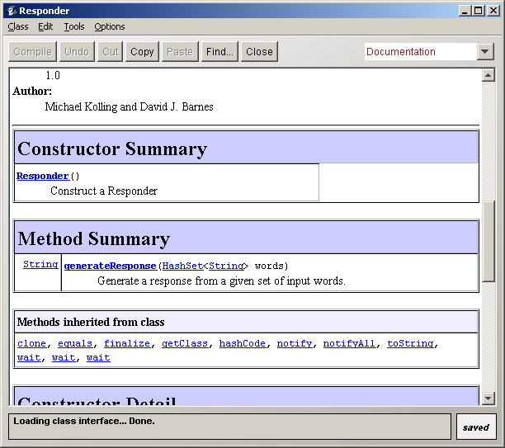
javadoc preview
This allows an immediate preview of the effect of your javadoc comments
  No excuses for poor quality!

Slide 14
Documentation is more than this!
Programs can be self-documenting by carefully selecting
  Names of variables
  Names of methods
  Names of parameters
  Names of classes
  What you place in each of the above
Notes:
SDJ Lecture 9: Creating Reliable Programs
© Swinburne & © Pearson Education IncA Bayley
A Bayley

Slide 15
Style Guides, Sun's Attitude
Code Conventions for the Java Programming Language
1. Introduction
1.1 Why Have Code Conventions
  Code conventions are important for a number of reasons
  80% of the lifetime cost of a piece of software goes to maintenance
  Hardly any software is maintained for its whole life by the original author
  Code conventions improve the readability of the software, allowing engineers to understand new code more quickly and thoroughly
  If you ship your source code as a product, you need to make sure it is as well packaged and clean as any other product you create
Notes:
SDJ Lecture 9: Creating Reliable Programs
© Swinburne & © Pearson Education IncA Bayley
A Bayley

Slide 16
Reading
Barnes & Kolling Section 5.10 and Appendix I for javadoc
http://www.mcs.csueastbay.edu/~billard/se/cs3340/ex7/javadoctutorial.html
Notes:
SDJ Lecture 9: Creating Reliable Programs
© Swinburne & © Pearson Education IncA Bayley
A Bayley

Slide 17

References
Coding standards:
http://geosoft.no/development/javastyle.html
BlueJ has code completion in its editor:
Type Ctrl-space after a dot
This shows a list of available
methods with their javadoc.
Press Enter to select one.
Notes:
SDJ Lecture 9: Creating Reliable Programs
© Swinburne & © Pearson Education IncA Bayley
A Bayley

